Slide 1

Lunar Base 3D Printing Robot
GitHub

Slide 2
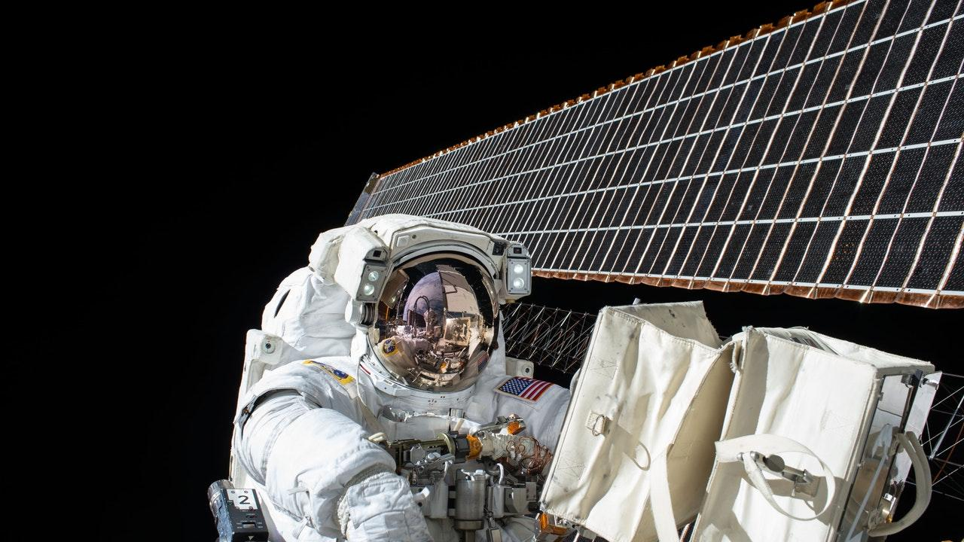
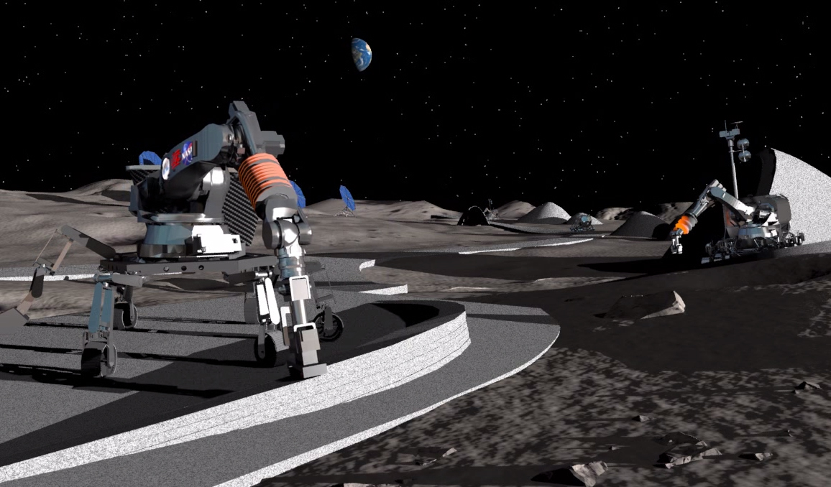
Want to Build a Moon Base? Easy.
Just Print It!

Slide 3
1.
Project Overview
3D printing Concept

Slide 4
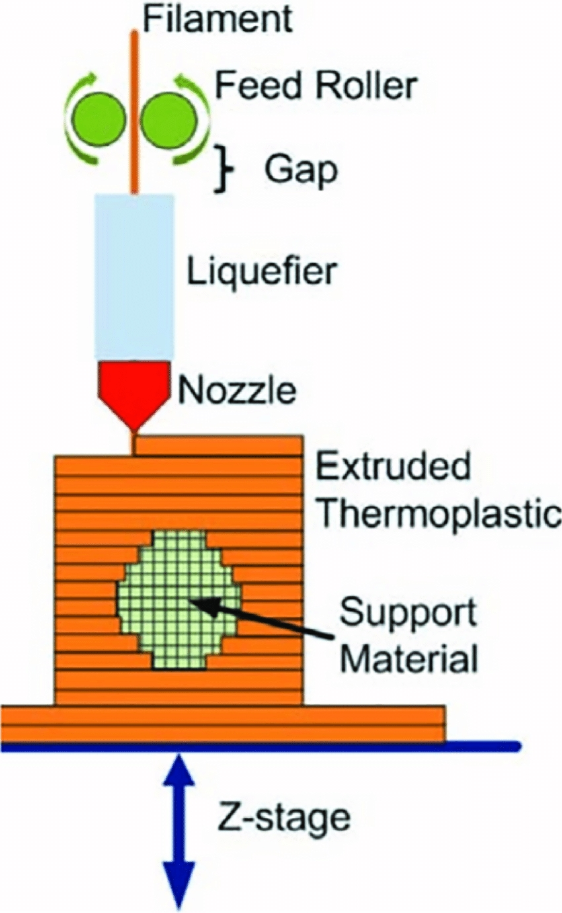
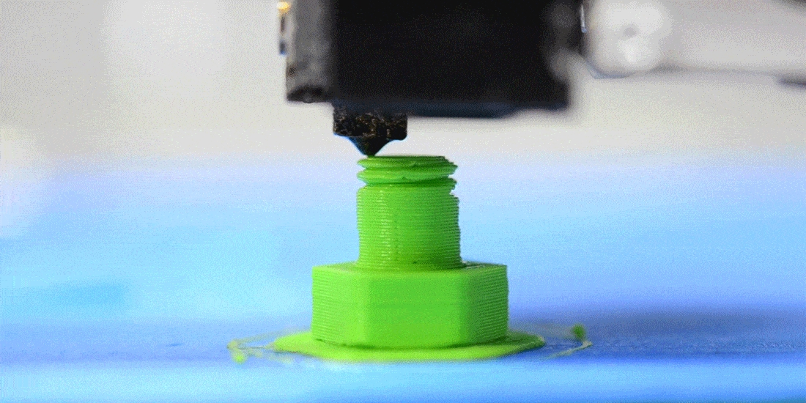
How A 3D Printer Works

Slide 5
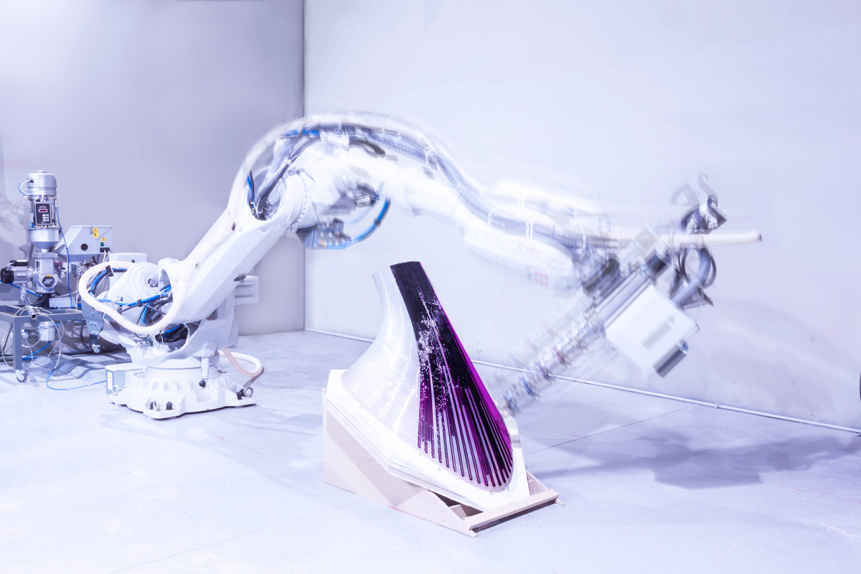
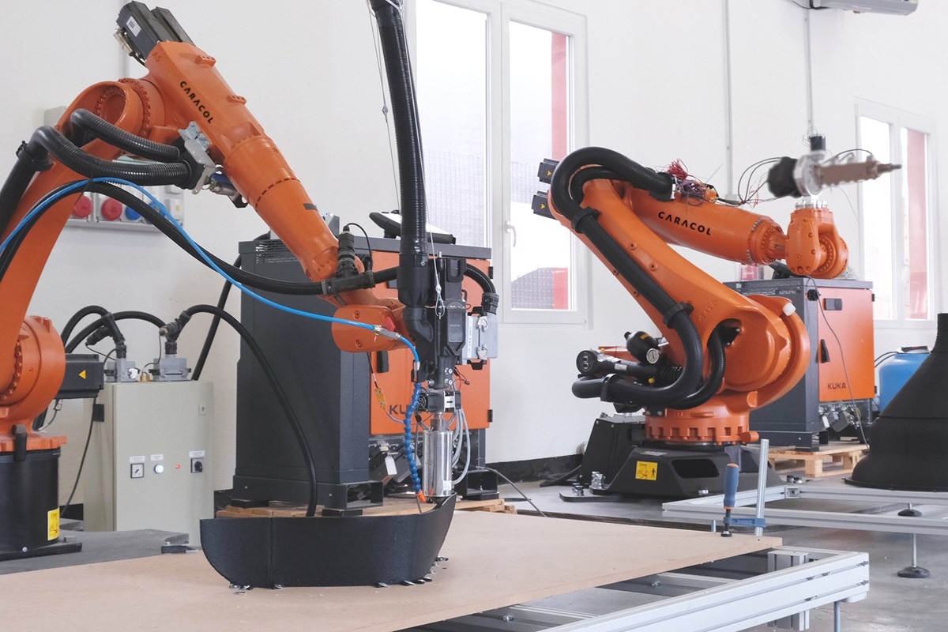
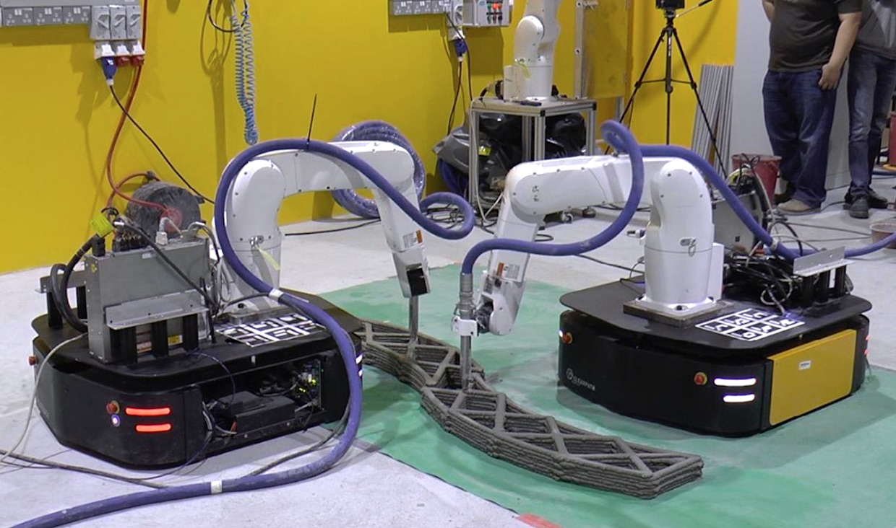
different types of 3D Printing robots
Mobile Robots 'Swarm Print' 3D large scale structures
KUKA 3D Printing technology used to manufacture large scale pieces
Large scale Robotic 3D Printed Furniture

Slide 6
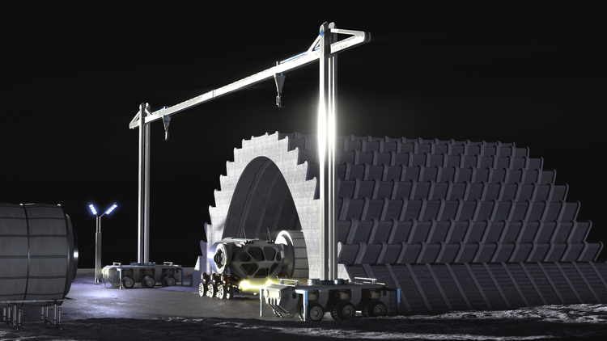
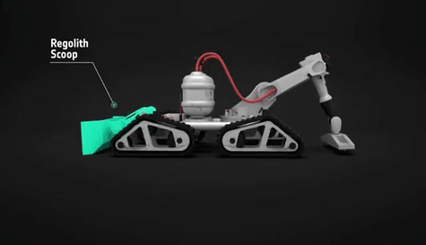
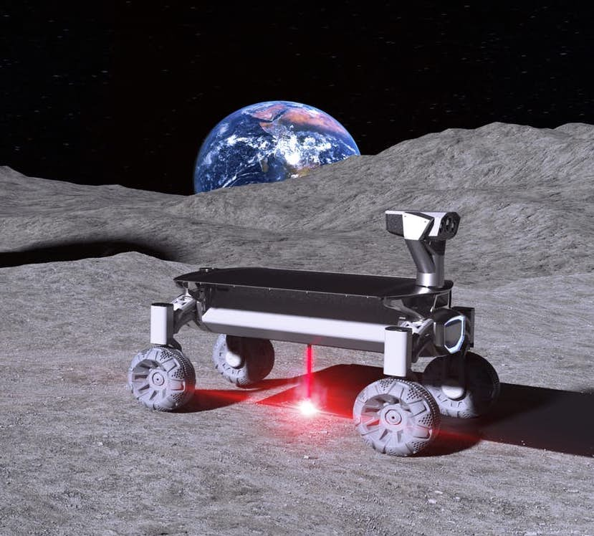
Project Olympus-NASA
3D Print Robot-ESA
PROJECT MOONRISE:
This technique involves using a laser to turn a very small amount of energy into heat that can melt and fuse together grains of regolith to form a thin but solid slice of the material. By repeating this process multiple times and adding more layers in sequence, we can eventually build a three-dimensional object.

Slide 7
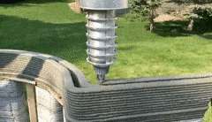
Contour Crafting Technology
The basic CC technology, works using layering of paste material extruded through a nozzle which is maneuvered by a gantry or a mobile robot.
Automated building technology such as Contour Crafting is critical to improving astronaut safety in construction scenarios.

Slide 8
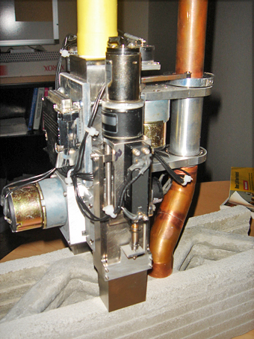
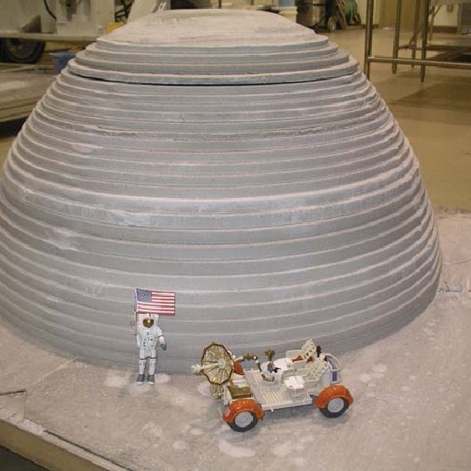
Prototype of Lunar Dome structure printed with CC technology
CC nozzle with co-extrusion building walls with corrugated fill

Slide 9
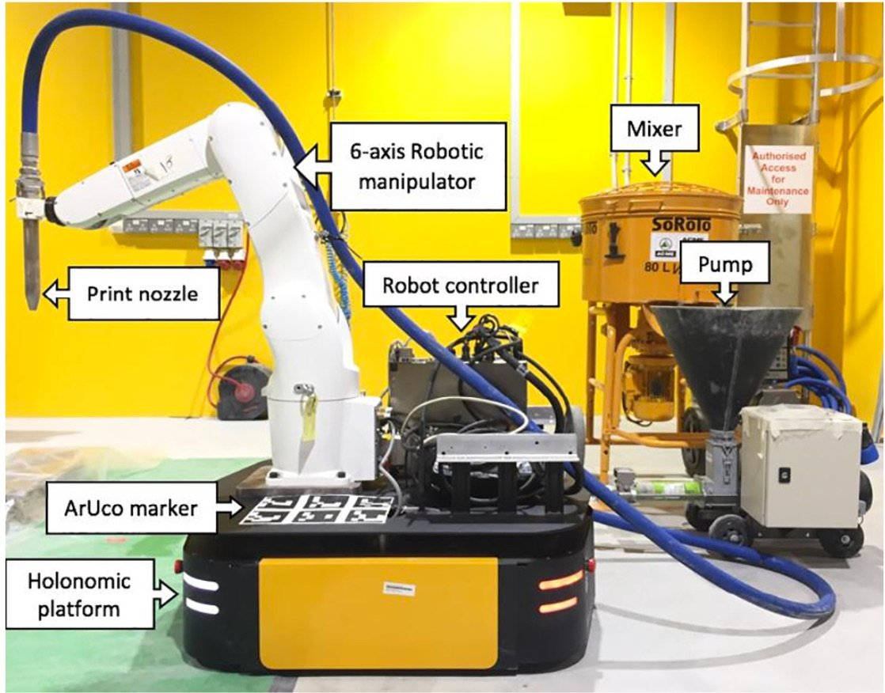
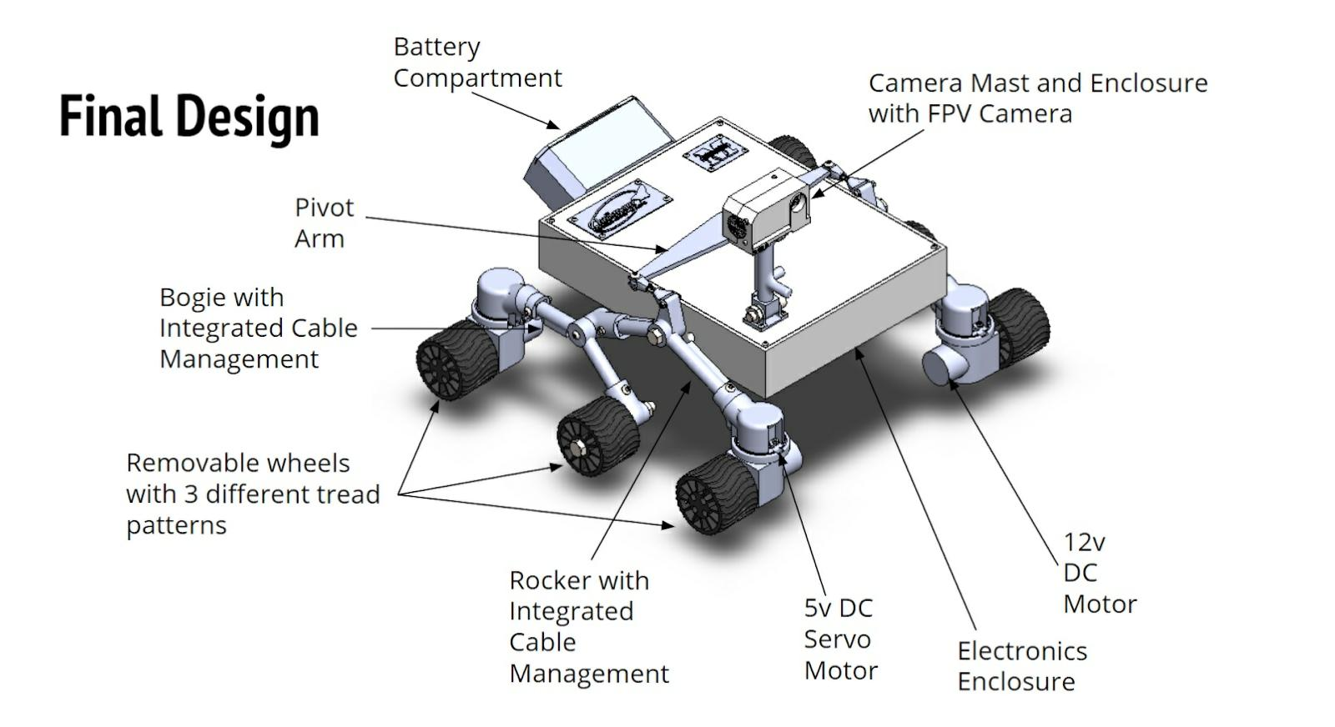
Robot features

Slide 10




3D Modeling & Simulation Tools
3D Modeling
Simulation Engines

Slide 11
2.
Roadmap
Timeline & Tasks

Slide 12
Roadmap
Getting Started siderations
Meeting 3: Robot simulation environment
Continue with improving the prototype
1
3
5
2
4
6
Meeting 2: 3D model
August 22nd: Project Poster deadline
August 26th: AJCC

Slide 13
Getting Started
3D Print Robot Prototype
Phase 1: 3D Modeling
Phase 2:Simulation
Sketch /robot feautures
3D Design & Assembly
Virtual environment
Robot simulation

Slide 14
Task Distribution
 | Week 1 |  |  |  |  |  |  | Week 2
 | 15 AUG | 16 AUG | 17 AUG | 18 AUG | 19 AUG | 20 AUG | 21 AUG | 22 AUG | 23 AUG | 24 AUG | 25 AUG | 26 | - | -
Task 1:Robot sketch
Task 2:Robot Features
Task 3:Base Assembly
Task 4:Arm Assembly
Task 5: Virtual Environment
Task 6: Robot Simulation
Task 7:
Task 8

Slide 15
Thanks!
ANY QUESTIONS?

Slide 16
Weekly Planner
 | SUNDAY | MONDAY | TUESDAY | WEDNESDAY | THURSDAY | FRIDAY | SATURDAY
09:00 - 09:45 | Task | Task | Task | Task | Task | Task | Task
10:00 - 10:45 | Task | Task | Task | Task | Task | Task | Task
11:00 - 11:45 | Task | Task | Task | Task | Task | Task | Task
12:00 - 13:15 | ✔ Free time | ✔ Free time | ✔ Free time | ✔ Free time | ✔ Free time | ✔ Free time | ✔ Free time
13:30 - 14:15 | Task | Task | Task | Task | Task | Task | Task
14:30 - 15:15 | Task | Task | Task | Task | Task | Task | Task
15:30 - 16:15 | Task | Task | Task | Task | Task | Task | Task

